Slide 1
CSM 478 COMPUTER NETWORKS LECTURE 2: INTERNETWORKING BASICS
FRIMPONG TWUM

Slide 2
Networking overview
Recap from Lecture 1
What is an internetwork? How is it created?
What is the difference between the Internet and www?
Define 3 types of network nodes (workstations, hosts, Servers)
How does nodes attach to network?
Answer: Nodes are attached to networks through communications media via Network Interface Card (NIC)

Slide 3
What is NIC?
The NIC is a board that is installed in the computer or network device.
In many computers, the NIC is built into the main board.
One end of the NIC is accessible on the outside of the workstation via a connector for attachment to the communications media.
The NIC may also be a separate card that is inserted into an expansion slot on the computer.
Imprinted on a NIC is a Hardware address known as Media Access Control (MAC) address.
MAC addresses (aka Physical Addresses) is unique for every host device.

Slide 4
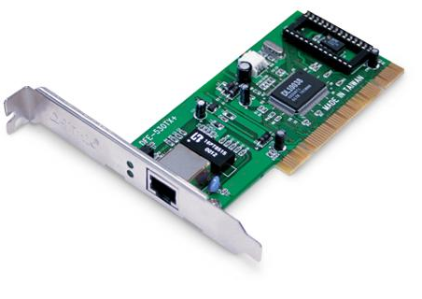
NIC EXPANSION CARD

Slide 5
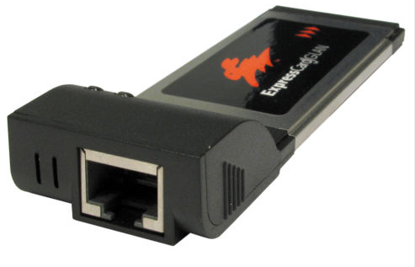
NIC EXPANSION CARD (PCMCIA)

Slide 6
NETWORKING HARDWARE OR NETWORKING DEVICES
Repeaters (also called amplifiers) – electronic devices that receive signals and amplify and send them along the network
Hub/Switches – electronic device (with a number of ports) used in a LAN to link groups of computers
Routers - electronic devices used to ensure messages are sent to their intended destinations
Bridge – consists of hardware and/or software that allows communication between two similar networks
Gateway – consists of hardware and/or software that allows communications between dissimilar networks

Slide 7
REPEATERS
A common problem in the networking world is that of weakening electrical signals. Electrical signals traveling through wires (such as copper wires used in most networks), weaken due to the wire's electrical resistance. This effect limits the lengths of the cable that can be used. A repeater will overcome this limit, when there is a need to connect two computers at a larger distance.
A repeater is connected to two cable segments. Any electrical signal reaching the repeater from one segment, will be amplified and retransmitted to the other segment.
An illustration of a repeater at work The electrical signal entering the repeater at one end is weakened. The repeater amplifies the electrical signals and resends the data.

Slide 8
HUBS
The original Ethernet LANs (PHYSICAL BUS) relied on certain physical characteristics of the cable carrying the network data (usually coaxial cable). New Ethernet technologies introduced new cable types that were unable to fulfill the original physical requirements. New devices - HUBS - were introduced to simulate those characteristics.
Simply put, the hub's major function is to replicate data it receives from one device attached to it to all other devices.
Using hubs in your network can contribute to congestion on your Ethernet network

Slide 9
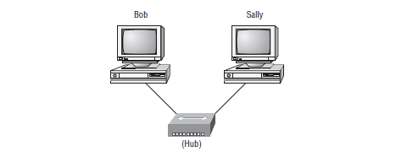
A BASIC LAN USING A HUB
How does Bob communicate with Sally?
How many COLLISION DOMAIN(S) are there?
How many BROACAST DOMAIN(S) are there?

Slide 10
How does Bob communicate with Sally?
The two hosts (Bob and Sally) communicate using their hardware or MAC addresses
How does Bob get Sally’s MAC address since he knows only Sally’s name and does not even have her IP address yet?
Bob will begin what is known as Hostname to IP address resolution since he knows only Sally’s name
Scenario 1 – If the two hosts are on different Networks, then this will Require a Domain Name Service (DNS)
Scenario 2 – If the two hosts are on the same LAN, then Bob can just send a BROADCAST massage to all hosts on the network to request for the required info

Slide 11
Scenario 2: Hostname to IP Address resolution
Before the name (Sally) is resolved, the first thing Bob has to do is to BROADCAST on the LAN to get sally’s MAC address so he can communicate to her PC and resolve her name to an IP address
A simple name resolution broadcast message from Bob to Sally is as shown
The NetBIOS Name Service (NBNS) is a legacy protocol, superseded by many functions of DNS. NetBIOS is usually only used over local networks, because it doesn't scale well past a few dozen workstations. Over vast TCP/IP networks, DNS is far more versatile and useful. The NBNS protocol is also known as Windows Internet Name Service (WINS) on Windows systems.

Slide 12
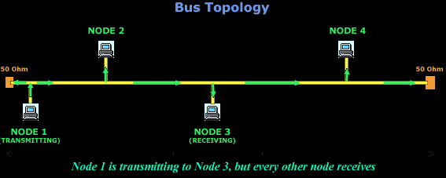
Bus Topology (One Collision Domain and One Broadcast Domain)

Slide 13
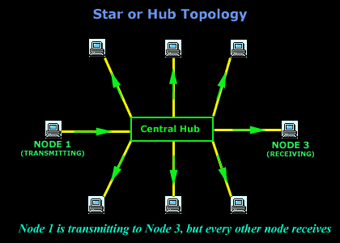
Star Or Hub Topology (One Collision Domain and One Broadcast Domain)

Slide 14
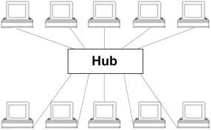
NETWORK SEGMENTATION
As the number of hosts on a hub network increases, the network performance deteriorate. Hub networks are usually limited to a maximum of up to ten (10) hosts.
NOTE: Hubs do not segment a network. Hubs just connect hosts on a particular network segment together.

Slide 15
NETWORK SEGMENTATION ctnue.
It is however likely the number of hosts will rise at some point and we’ll have to break up one large Hub network into a bunch of smaller ones
The network terminology for breaking up a big network into a number of smaller ones is called Network Segmentation.
We segment a network with devices like Switches, Routers, and Bridges.

Slide 16
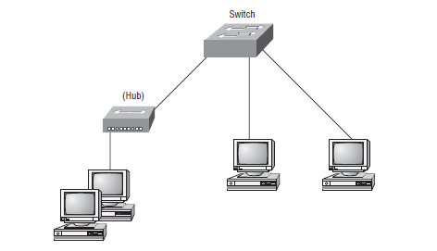
Network Segmentation with a SWITCH
How many COLLISION DOMAIN(S) are there?
How many BROACAST DOMAIN(S) are there?
The SWITCH replaces the HUB, and break up the collision domains.
Each network segment connected to the switch is now a separate collision domain.
There is however still one (1) broadcast domain.

Slide 17
CAUSES OF LAN TRAFFIC CONGESTION
Above network design still has problem with traffic congestion. Causes of LAN traffic congestion include:
Too many hosts in a single broadcast domain
Broadcast storm
Multicasting
Low Bandwidth
Adding hubs for connectivity to the network
A bunch of ARP or IPX traffic
NOTE: A switch does not break up Broadcast Domain.
Using a switch is an inexpensive way to connect a couple of PCs together for home or small office network.

Slide 18
ROUTERS
Routers are used to connect separate networks together and route packets of data between them.
Routers, by default, break up a Broadcast Domain (Thus: the set of all devices on a network segment that hear all the broadcasts on that segment).
Routers in addition to breaking up broadcast domains, also break up collision domains
Routers create an internetwork and provide connections to WAN services

Slide 19
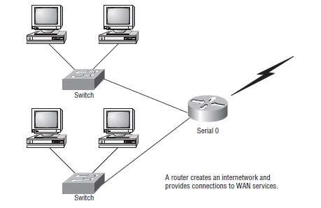
ROUTERS ctnue…
Each host in above network is connected to its own collision domain.
The ROUTER in above network has created two(2) broadcast domains and also provides connections to WAN services through its serial interface.

Slide 20
Some advantages of Using Routers
Unlike Switches, Routers by default do not forward broadcasts.
Routers can filter a network based on layer 3 (Network Layer) information (e.g. IP address)
Functions of a Router
Packet Switching
Packet filtering
Internetwork communication
Path selection

Slide 21
ROUTERS
Routers connect two or more networks and forward data packets between them. When data arrives from one of the segments, the router decides, according to it's routing table, to which segment to forward that data.

Slide 22
Router vrs. Switch
Routers are really Switches. Routers are actually known and called Layer 3 switches
Routers operate at layer 3 of the OSI model, & TCP/IP model
Switches (a.k.a. Layer 2 Switches) operate at layer 2 of the OSI model, and TCP/IP model
Switches do not create internetworks
Switches do not break up broadcast domains by default but break up collision domains by default
Switches main purpose is to make a LAN work better by providing more bandwidth to LAN users
Switches do not forward packets as do Routers. They instead, switch frames from one port to another within a switched network
Switches creates separate collision domains but a single broadcast domain. Routers on the other hand provide a separate broadcast domain for each of its interface

Slide 23
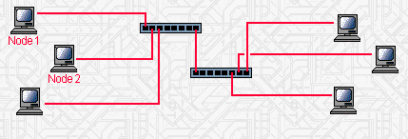
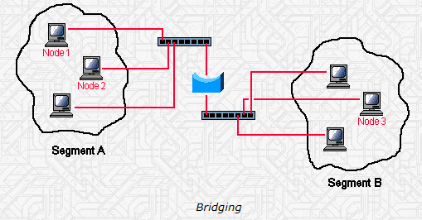
BRIDGES
A bridge is a network device that filters data traffic from one network to another network
Bridges reduce the amount of traffic on a LAN (fig.1) by dividing the LAN into 2 network segments as shown (fig.2)
fig. 1
fig.2

Slide 24
BRIDGES ctnue…
Bridges operate at the data link layer (Layer 2) of the OSI model.
Bridges inspect incoming traffic and decide whether to forward or discard it.
A bridge examines each data frame on a LAN, "passing" those known to be within the same LAN segment , and forwarding those known to be on the other interconnected LAN segment.
In bridging networks, computer or node addresses (MAC addresses) have no specific relationship to location. For this reason, messages are sent out to every address on the network and accepted only by the intended destination node.

Slide 25
BRIDGES ctnue…
Bridges learn which MAC addresses are on which network and develop a learning table (aka. Bridging Table so that subsequent messages can be forwarded to the right network.
Bridges interconnects LANs and prevent broadcasting of data frames to all possible destinations as this would flood a larger LAN with unnecessary traffic.
Unlike bridging networks, router networks such as the Internet use an addressing scheme (IP addresses) that have specific relationship to location. Routers assigns addresses to nodes so that packets can be forwarded only in one general direction rather than forwarded in all directions.

Slide 26
BRIDGES ctnue…
A bridge is sometimes combined with a router in a product called a brouter.
Bridges serve a similar function as switches, that also operate at Layer 2. Traditional bridges, though, support one network boundary, whereas switches usually offer four or more hardware ports. Switches are sometimes called "multi-port bridges" for this reason.
You would use a bridge in a network to reduce collisions within broadcast domains and to increase the number of collision domains in your network. Doing this provides more bandwidth for users.

Slide 27
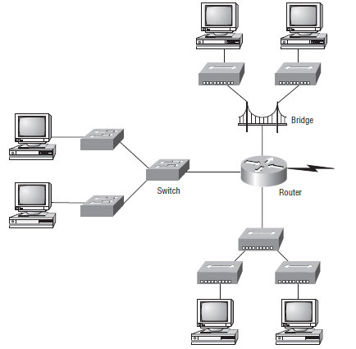
An example network with all Internetwork devices
Remember the router will not only break up broadcast domains for every LAN interface, but also break up collision domains.

Slide 28
GATEWAY
"Gateway" is a term that was once used to refer to a routing device. Today, in the TCP/IP world, the term "router" is used to describe such a device.
The term gateway now refers to special-purpose devices, that perform protocol conversions. Gateways implement application layer conversions of information received from various protocols.
Examples of gateways found on today's markets are:
VocalTec Gateway: A gateway that converts human speech traveling on analog phone lines into local area network protocol data, and visa-versa.
RadVision Gateway: Converts video from digital phone lines into local area network protocol data, and visa-versa.

Slide 29
MODEMS
An illustration of data sent using a modem and a regular telephone line.
A modem is a device that converts digital data originating from a terminal or computer, to analog signals used by voice communication networks such as the telephone system. At one end, modems convert the digital pulses to audible tones and convert audio tones back to digital pulses at the other.
The word "Modem" stands for "MOdulator-DEModulator".

Slide 30
MODEMS
Transmission speed
Modems are available in different transmission speeds, which are measured in BPS (bits per second) also called BAUD rate. Standard modems speeds: 9600 baud, 14400 baud, 28800 baud, 33600 baud, 56800 baud.
Internal/External
Internal modems are electronic cards. An internal modem is installed in one of the computer's expansion slot. External modems are fully functioning external devices. The external modem is connected to a computer using a serial cable to one of the computer's serial ports, and draws power from an external power source.

Slide 31
EXAMPLE OF FIREWALL
Firewalls are systems that establish access control policies among networks. They can block information from entering a network or from getting out of that network, they can permit different users to perform different kinds of operations, according to the user's authorizations.

Slide 32
OTHER COMMUNICATION PROTOCOLS
File transfer protocol (FTP) – used to transmit files.
Simple mail transfer protocol (SMTP) – used to transmit e-mail messages.
Post office protocol (POP) – allows the recipient to retrieve messages.
Wireless application protocol – enables wireless devices to access and use the Internet using a client/server network.
802.11 – protocol for wireless LAN technology

Slide 33
DATA TRANSMISSION CHARACTERISTICS
Bandwidth (rate of transmission)
Analog or Digital (type of signal)
Analog transmission – takes the form of continuous waves transmitted over a medium at a certain frequency rage
Digital transmission – sends data in the form of bits
Serial or Parallel (order of bits)
Serial transmission – all of the data bits are transmitted one bit after another in a continuous line
Parallel transmission – data bits are sent at the same time along multiple paths

Slide 34
COMMUNICATIONS SOFTWARE
E-Mail Software – used to send and receive electronic messages using the Internet
Web Browser – allows users to access and view Web pages
Groupware – allows groups of people on a network to share information and to collaborate on various projects

Slide 35
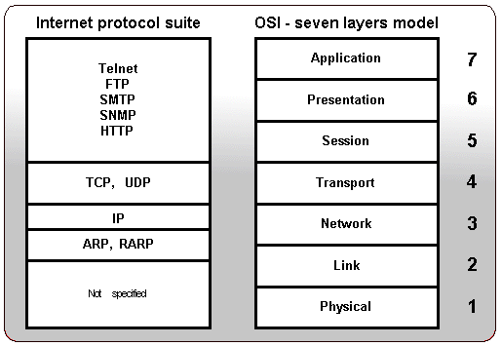
INTERNET PROTOCOLS

